Slide 1
John Matel – Virginia Tree Farm Foundation www.jmafe.com www.VirginiaTFF.org

Slide 2
“We abuse land because we regard it as a commodity belonging to us. When we see land as a community to which we belong, we may begin to use it with love and respect.”

Slide 3
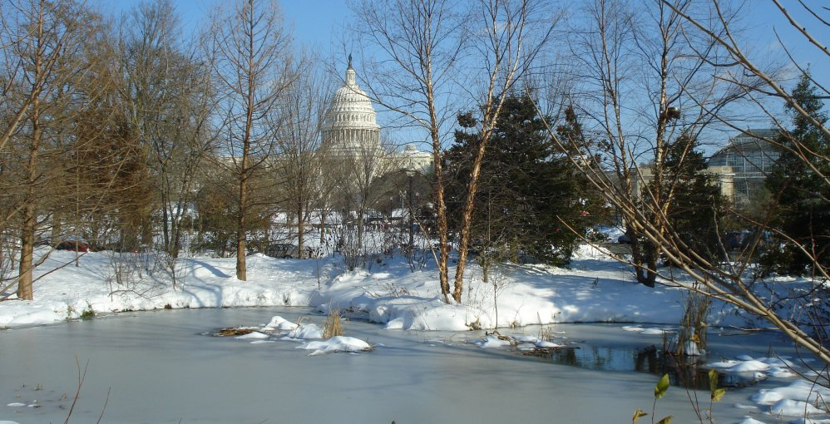
What I am going to tell you?
In this session, we will discuss and interactively develop ideas for engaging and getting people on our side, the side of good forestry.
I am going to tell you about the “social license” to do forestry, why we care, some ideas on how to communicate to protect our “license,” and I am going to tell you why I put “license” in scare quotes.
I have 22 slides, including three “wild cards” that include useful tips.

Slide 4
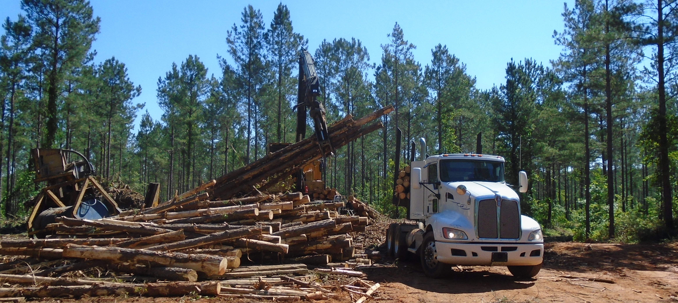
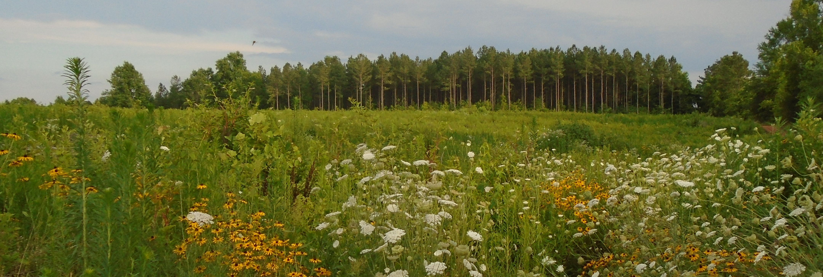
Telling the whole story
This is our challenge. We spend a lifetime growing trees and regenerating ecosystems. For these many years, our work is unnoticed, almost invisible. What most people know is the short time involved in harvest, and they misunderstand what they are seeing. For them, it is only noise, smoke mud and destruction. They see the end of beauty.
We see a beginning. We know from years of engagement with living communities on our land that harvest is just one phase -NOT one of destruction but of change, renewal &, regeneration.
Notes:
https://www.linkedin.com/pulse/forests-forever-john-matel/

Slide 5
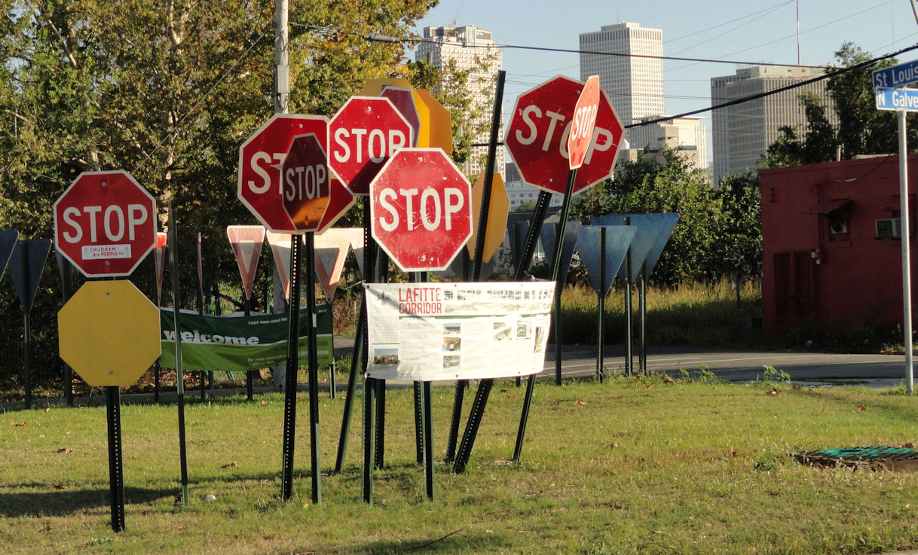
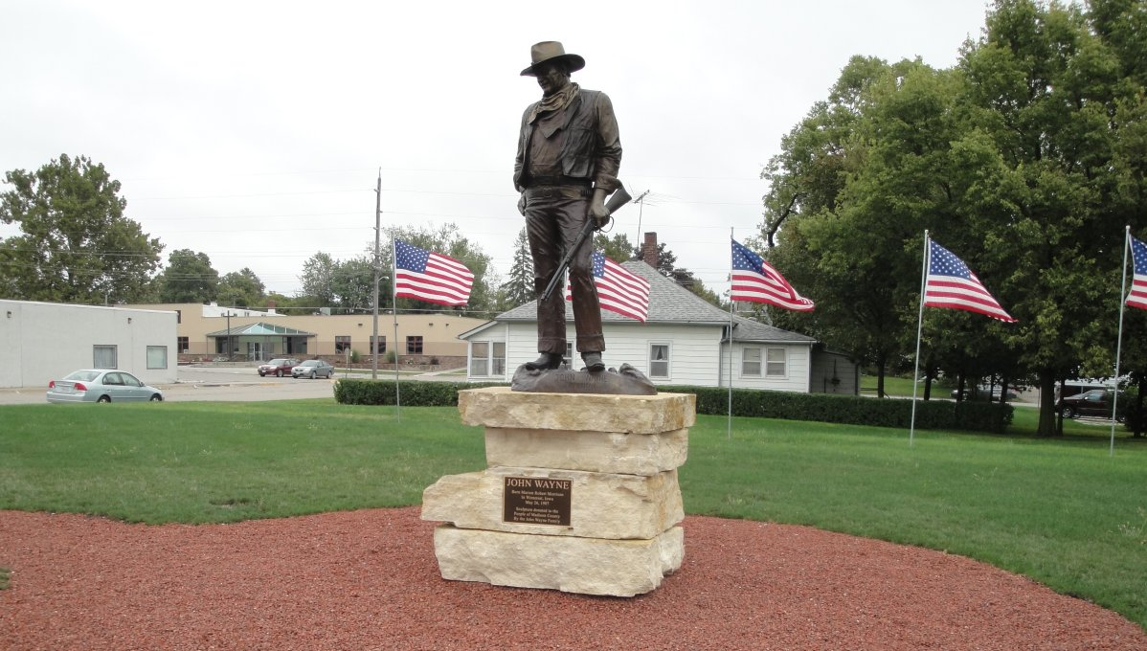
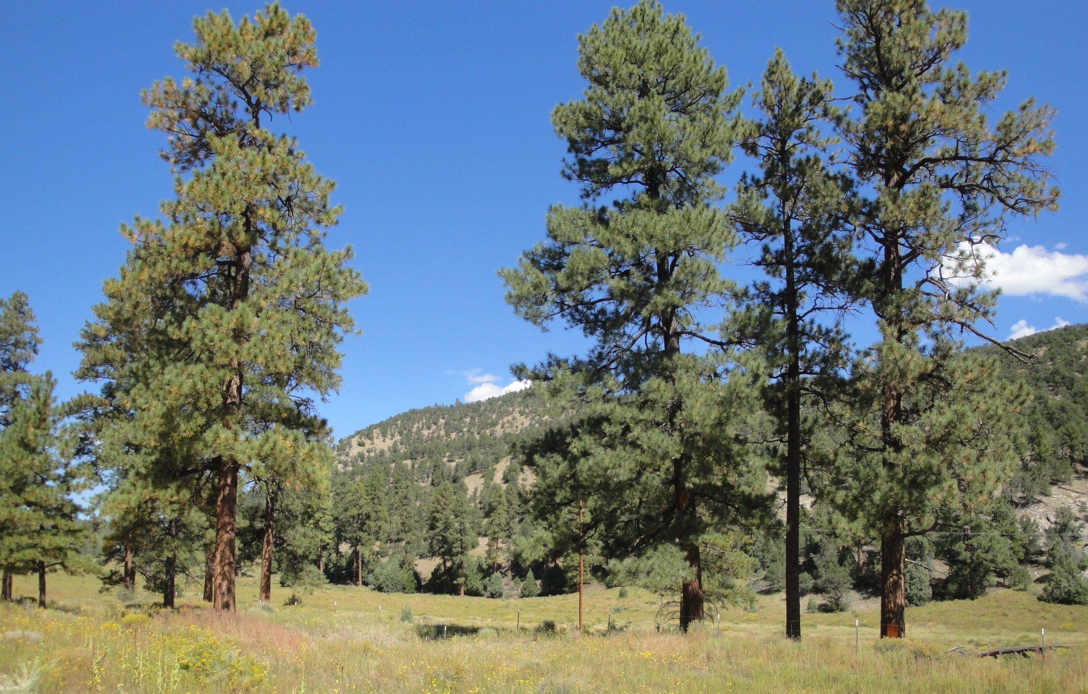
Who cares and why do we care if they care? Who are we talking to? Social License to Operate

Slide 6
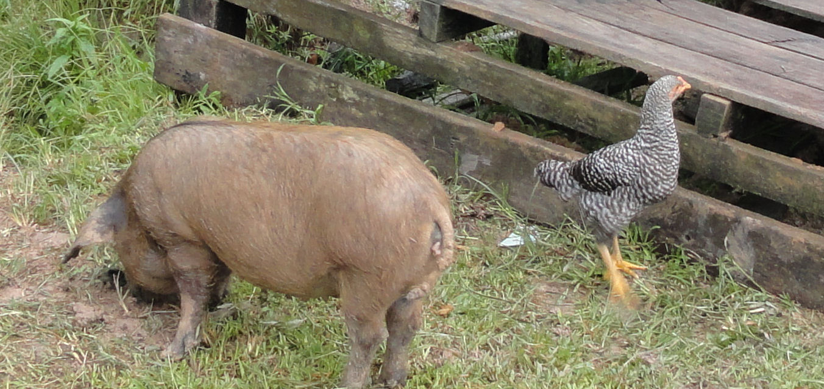
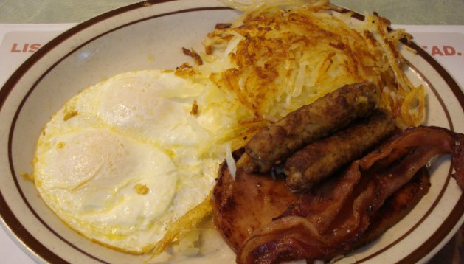
You – me – us – we are the messengers and the message
There are more than 44 state committees, with more than 73,000 Tree Farmers, managing more than 20.5 million acres.
This is a big number, not very big, but we have commitment. We are not “likes” on Facebook or “upvotes” on Reddit. Every tree farmer is root deep in the long term.
Let’s discuss commitment and the difference between commitment and involvement. Consider the bacon and eggs breakfast you had this morning. The hen is involved. The hog is committed.

Slide 7
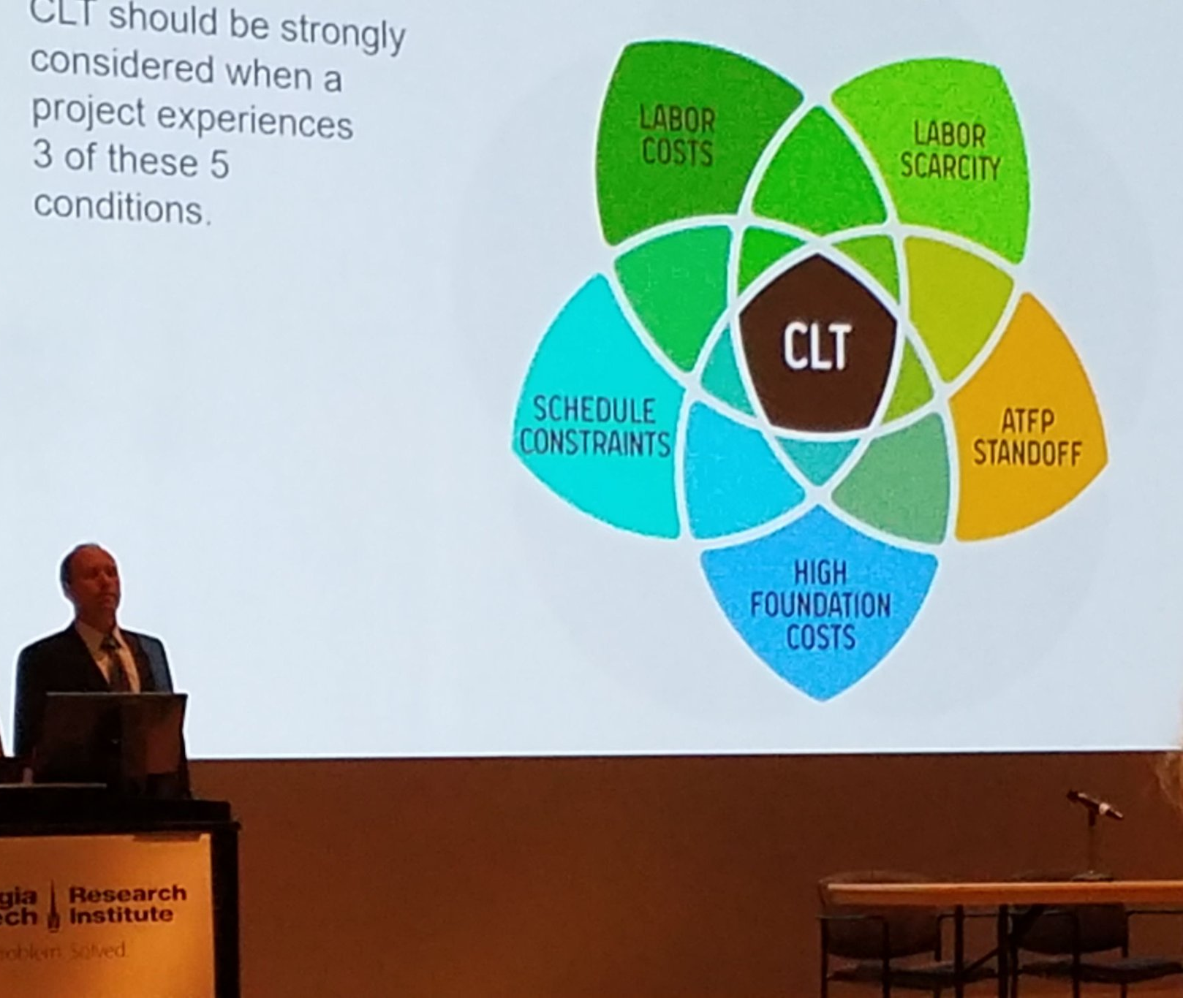
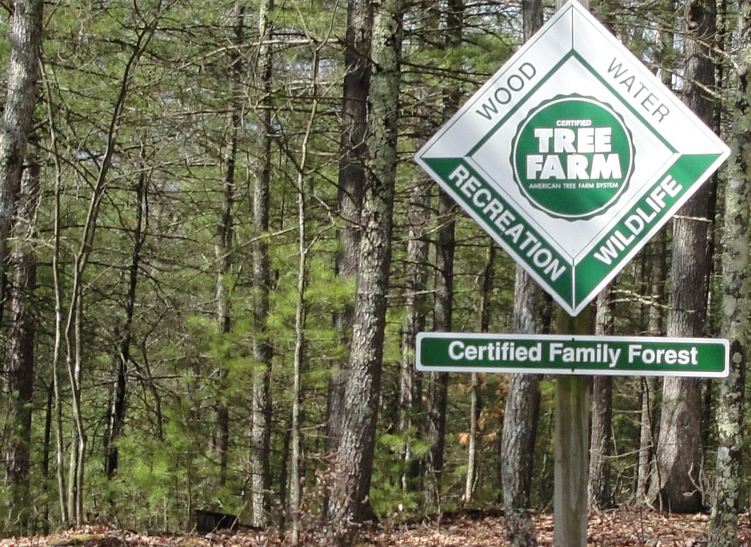
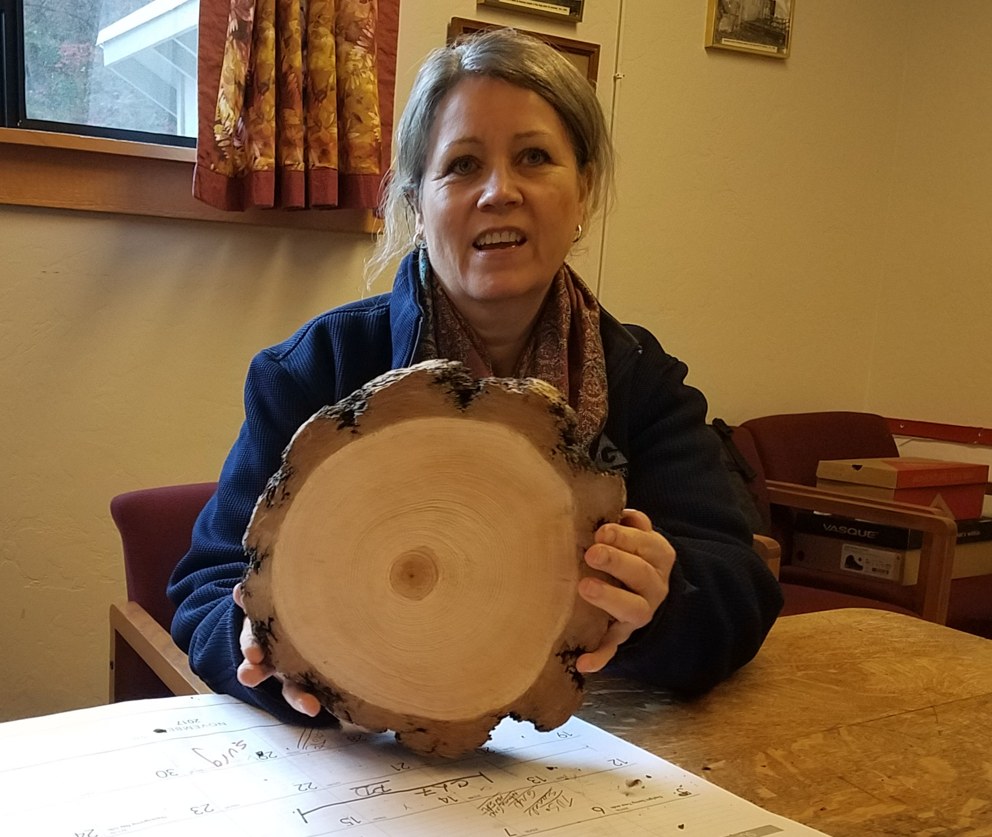
-- Talk about what you know -- Engage at as many levels as you can: touch, sight, sound, smell, even taste. -- Tell them only as much as they can believe. Human ecology
Notes:
https://www.linkedin.com/pulse/telling-forestry-story-john-matel/?published=t

Slide 8
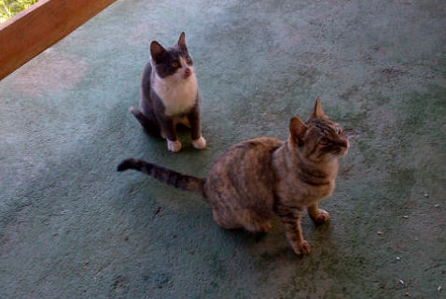
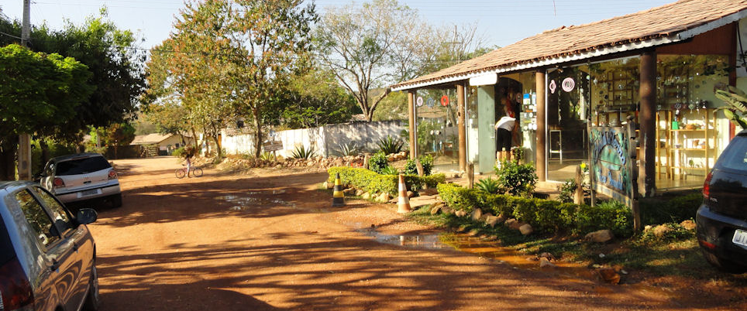
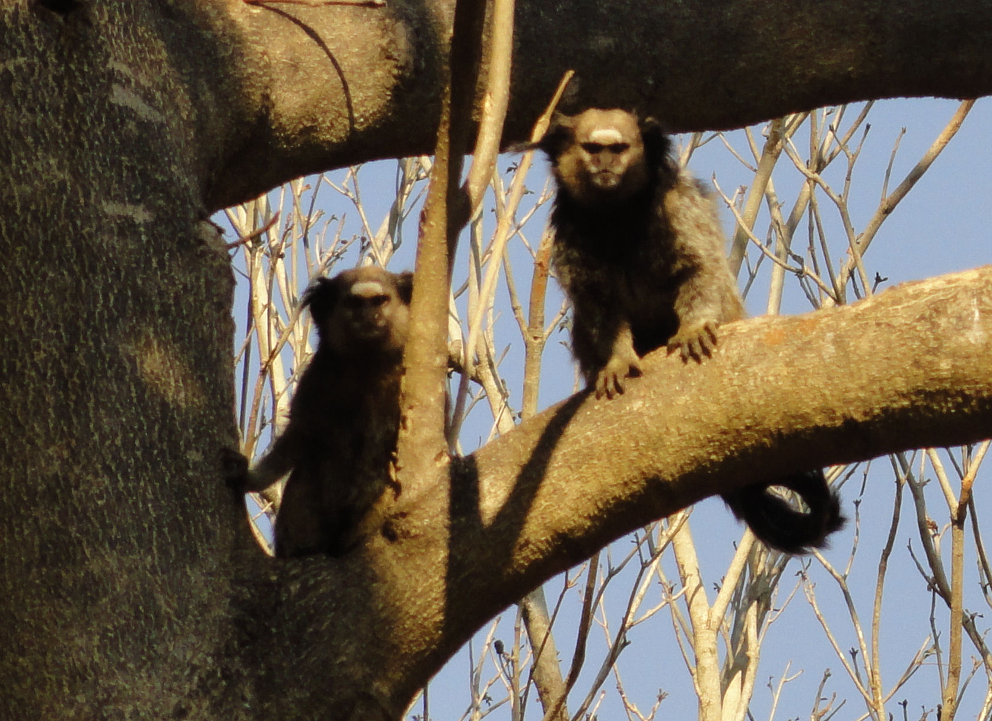
Dunbar number
A man’s gotta know his limitations

Slide 9
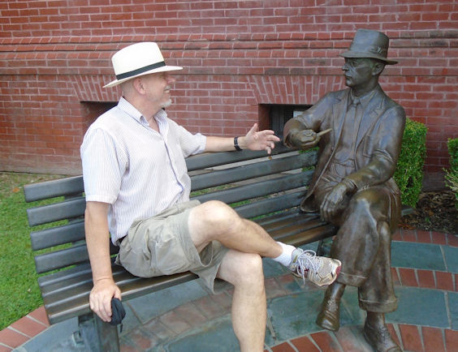
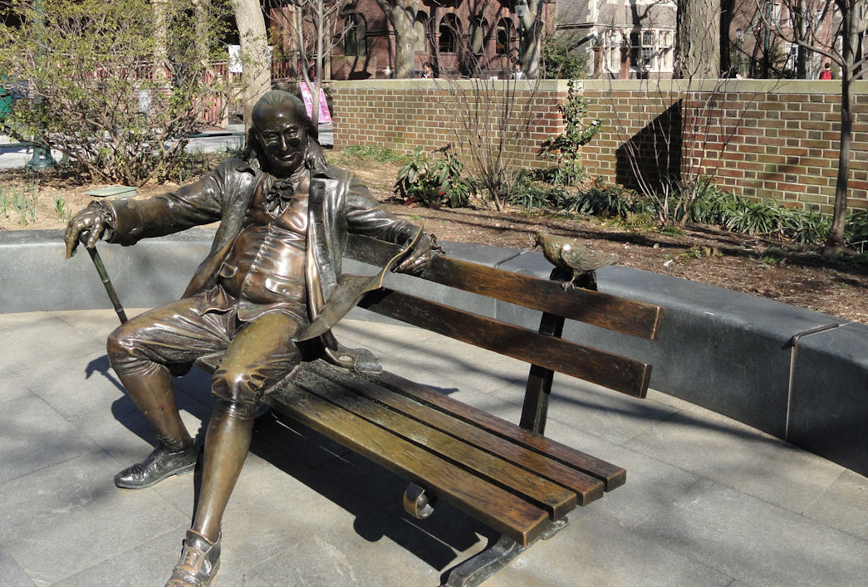
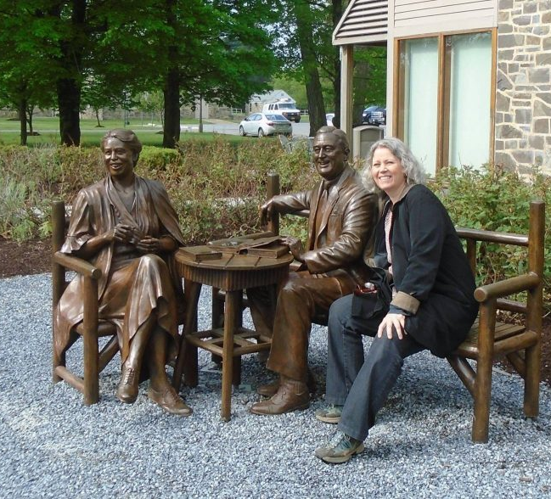
Wild Card # 1 - words & numbers
Numbers
Odd more interesting than even numbers
“Magic” numbers are 3, 7 & 12
150-250 Dunbar number
Memory devices
Words
Anglo-Saxon words
Evocative words
Words that begin with “i”
Short & long
Rhythm

Slide 10
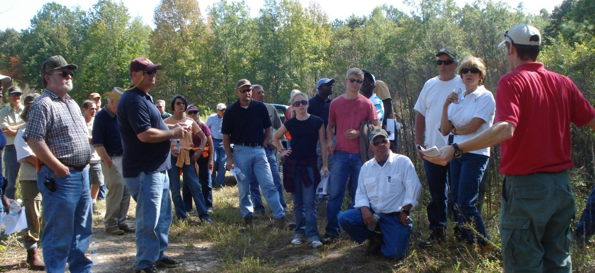
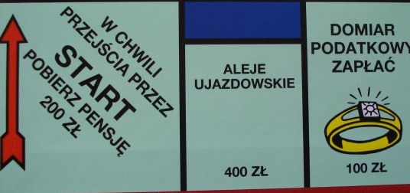
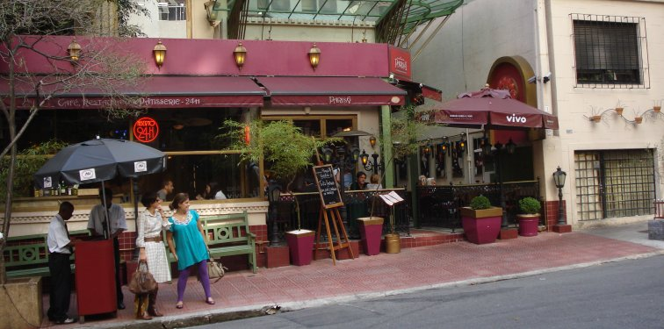
People
Humans are social creatures who make decisions in contexts of their culture & relationships
Understand - Everything has rules and patterns
Information is almost free and a wealth of information creates a poverty of attention. We need find or create social context to get attention.

Slide 11
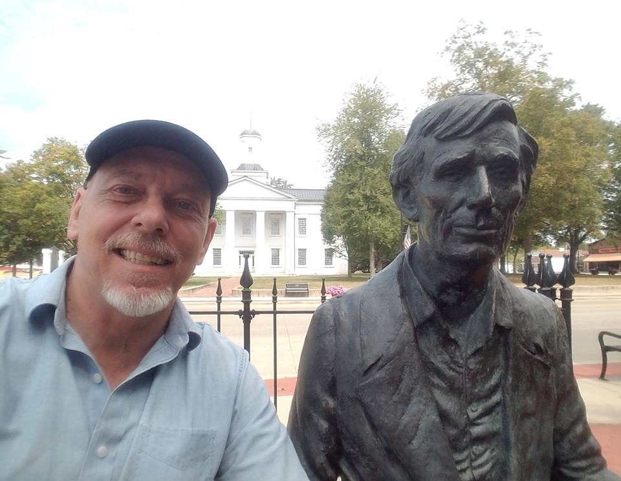
-- What you hoped to say doesn’t matter -- What you said doesn’t matter -- It doesn’t even matter what they heard. What matters is what they remember AND what they integrate into their mental ecology.
My talks to William Faulkner & young Abe Lincoln were interesting for me, but a bit one-sided.

Slide 12
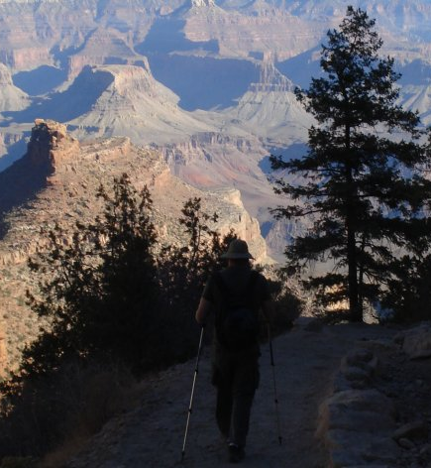
Wild Card # 2 - Some contrasts
Messaging versus engagement
Complicated versus complex
Converting versus collaborating
Closed versus open
Control versus freedom
Conservation versus preservation

Slide 13
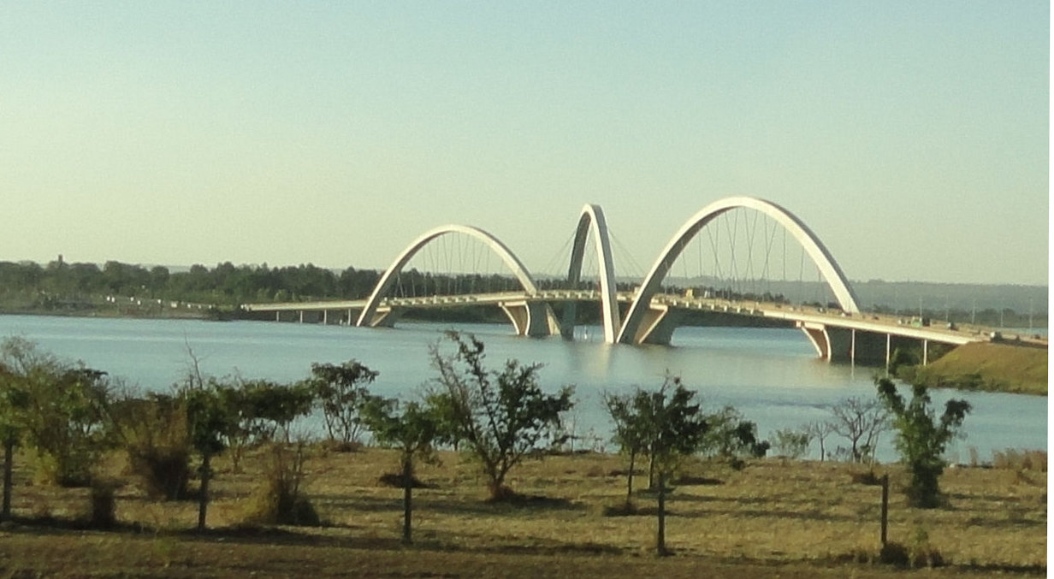
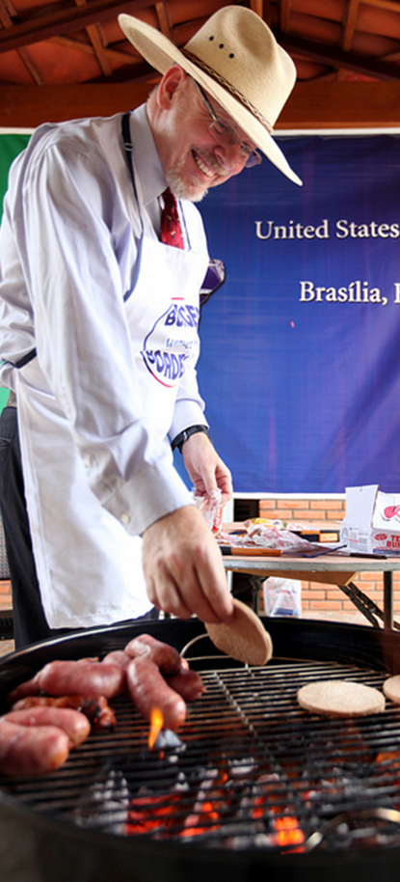
What works
Simple
Vivid
Personal
Positive
Bridge from known to new
Notes:
http://johnsonmatel.com/blog1/2011/12/burgers_wo_borders_and_pd_succ.html

Slide 14
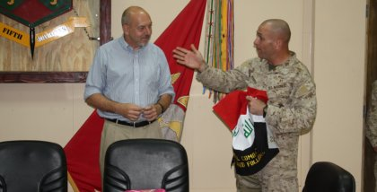
Inclusive & Exclusive - Communities are inclusive for members and exclusive for others. You attract nobody if you appeal to everybody. You have to earn membership in any community worth joining.

Slide 15
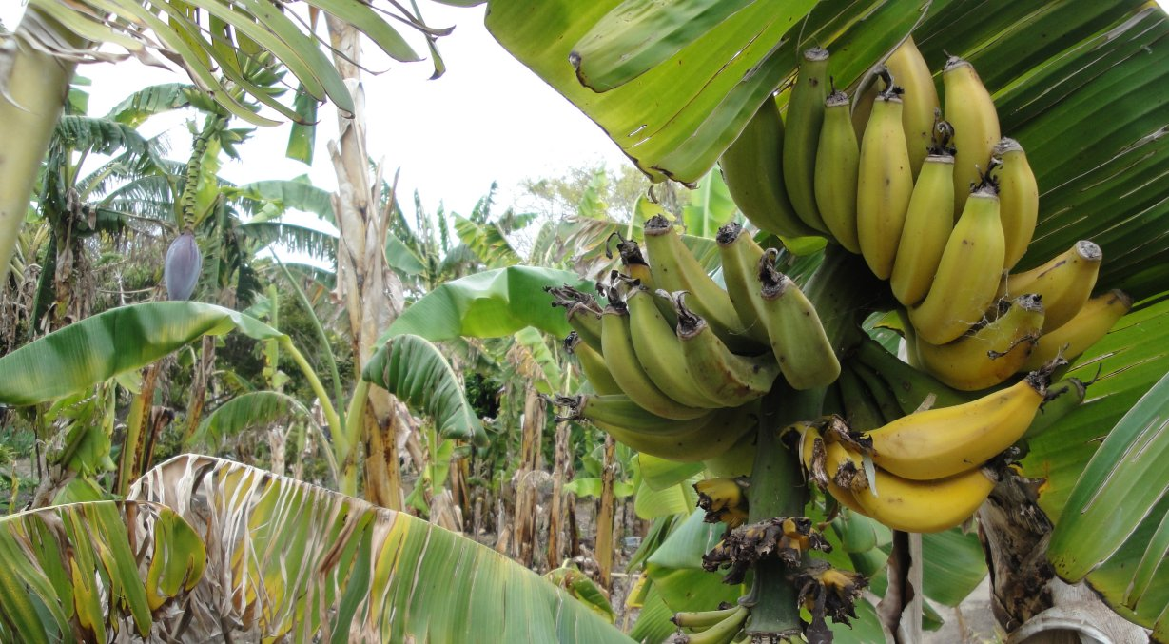
Yes, we have no bananas
These are the words from an old silly song. That I still remember them shows the usefulness of a memorable handle.
Meet people where they are and bridge from the negative to the positive. Emphasis what you have, not what you lack. And if you have nothing, still make it something "Yes, we have no bananas," brings a little positive levity. Nobody is fooled, but it takes the edge off, and from there you can move forward.
Notes:
http://johnsonmatel.com/blog1/2011/02/yes_we_have_no_bananas.html

Slide 16
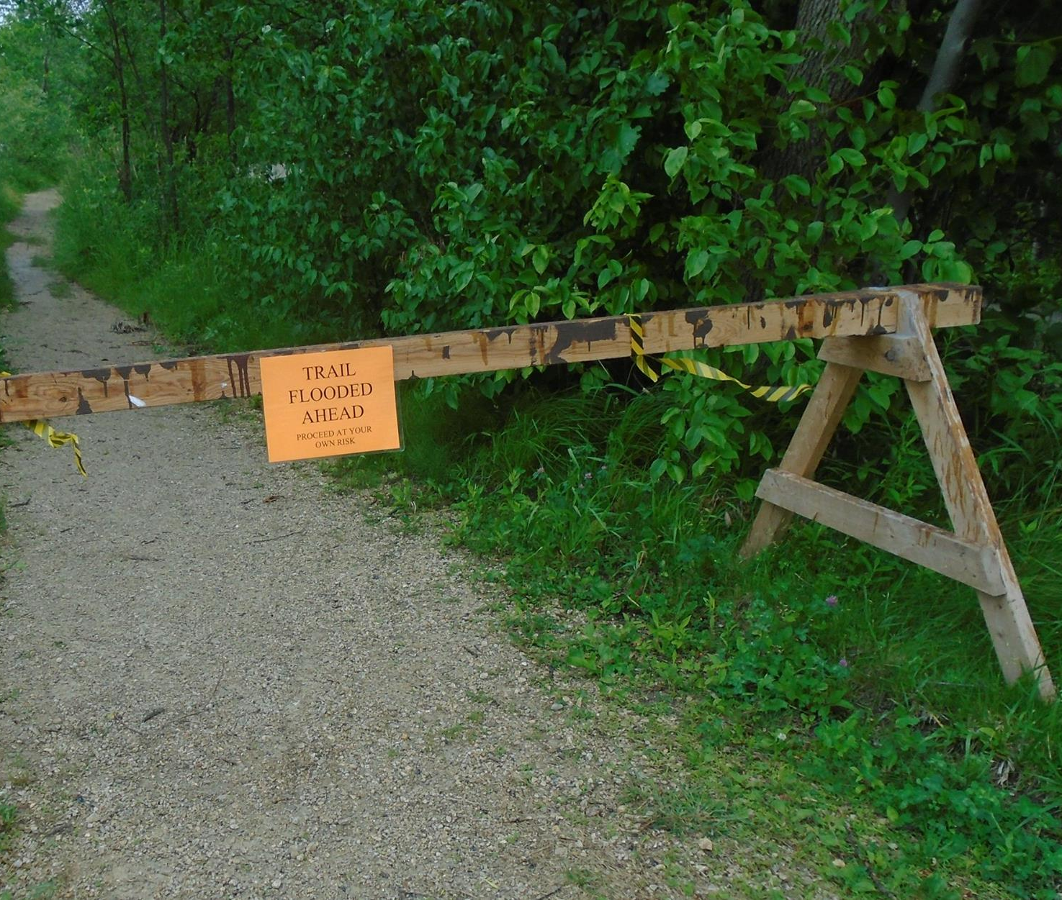
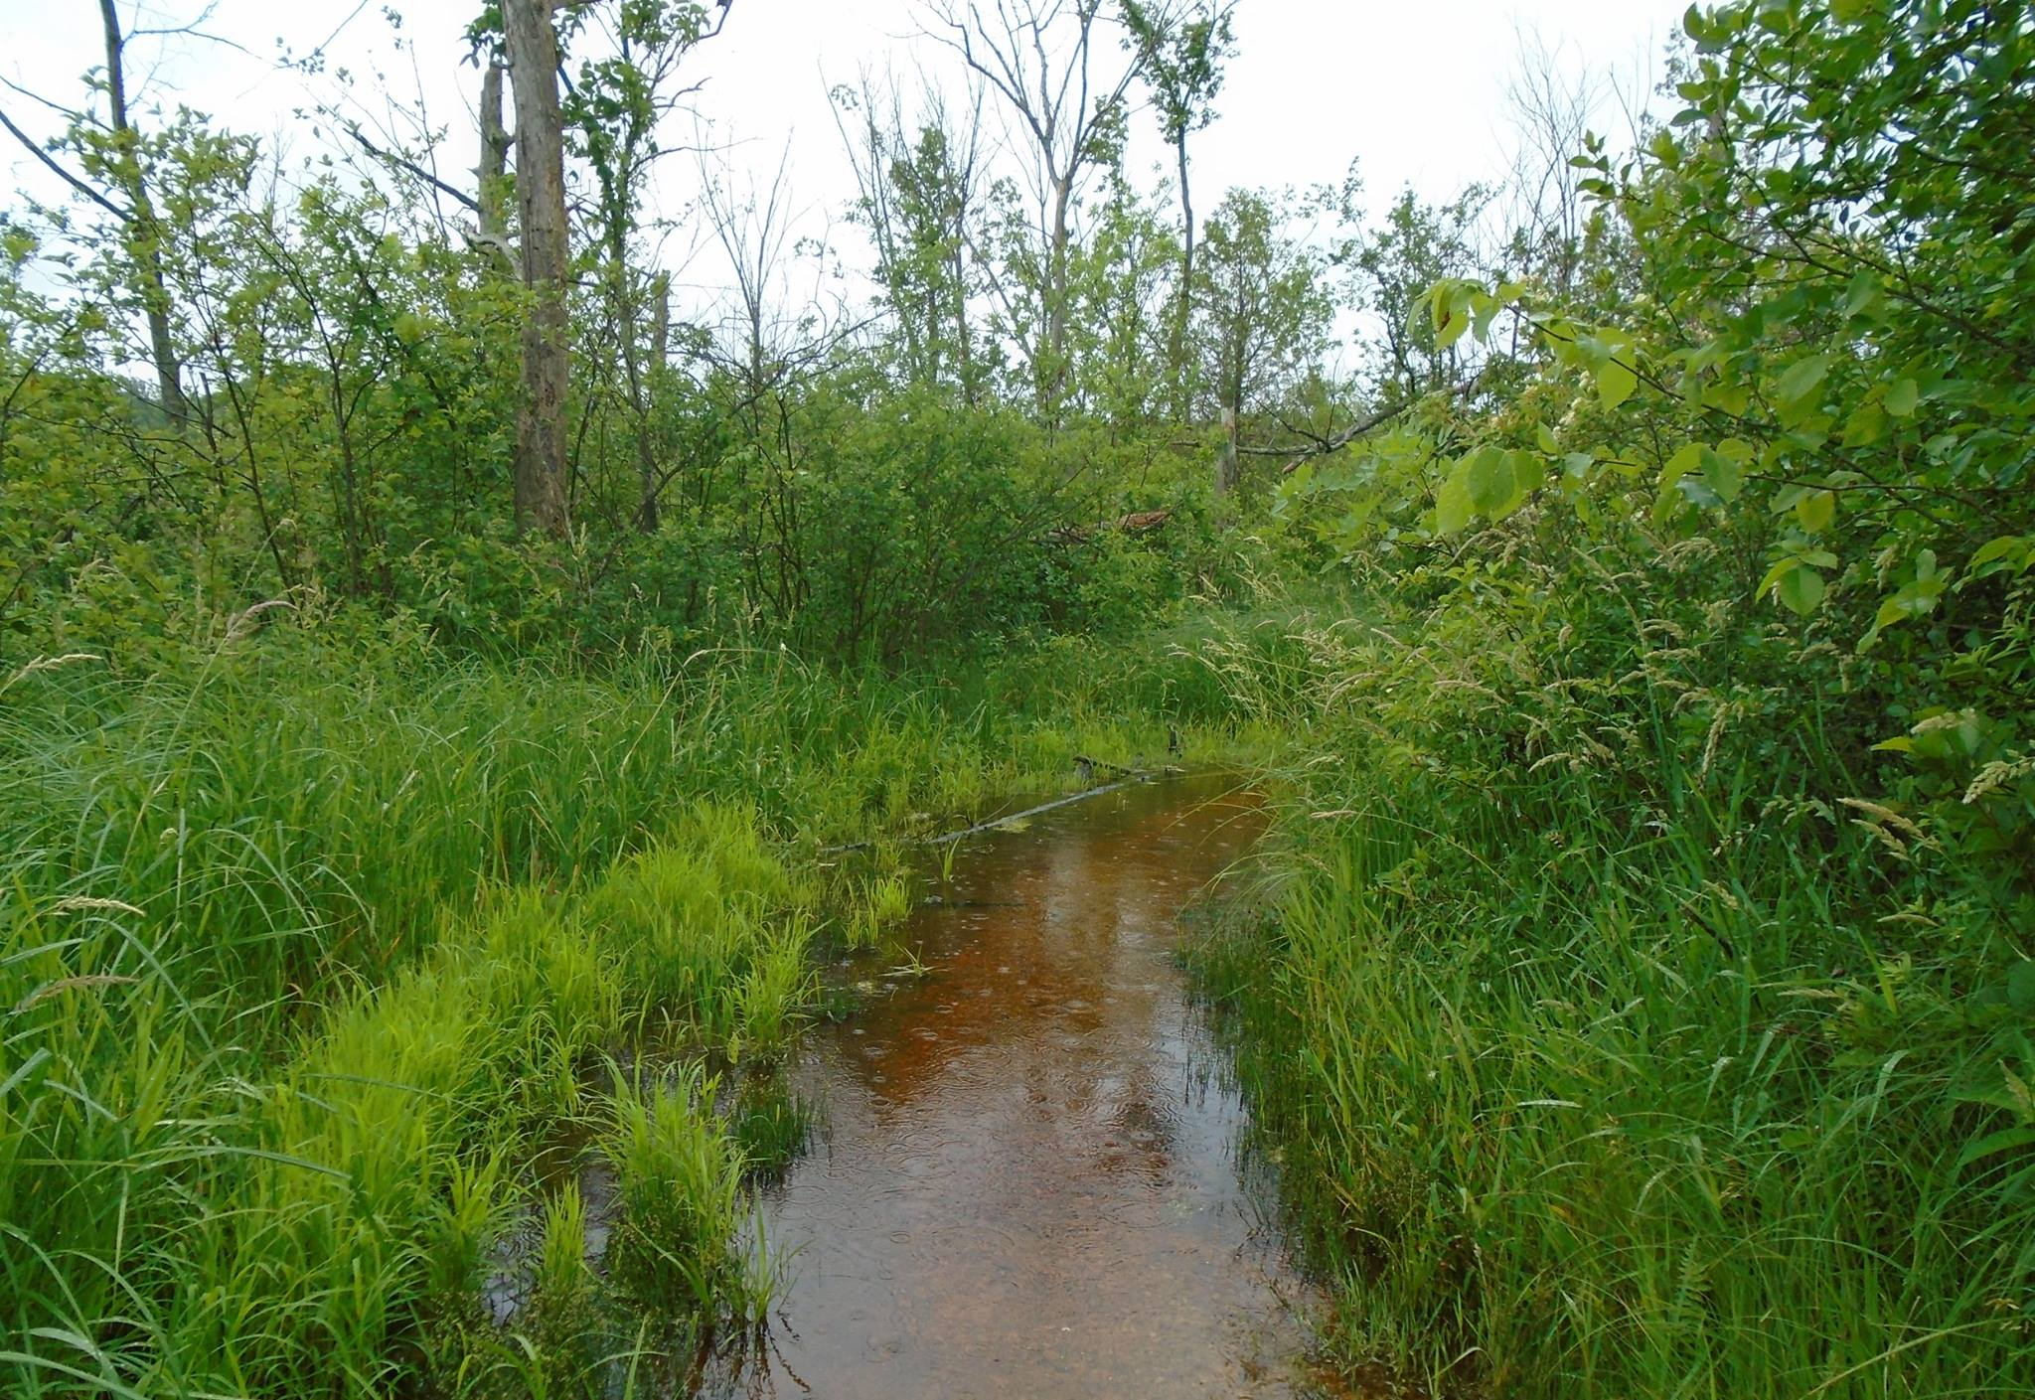
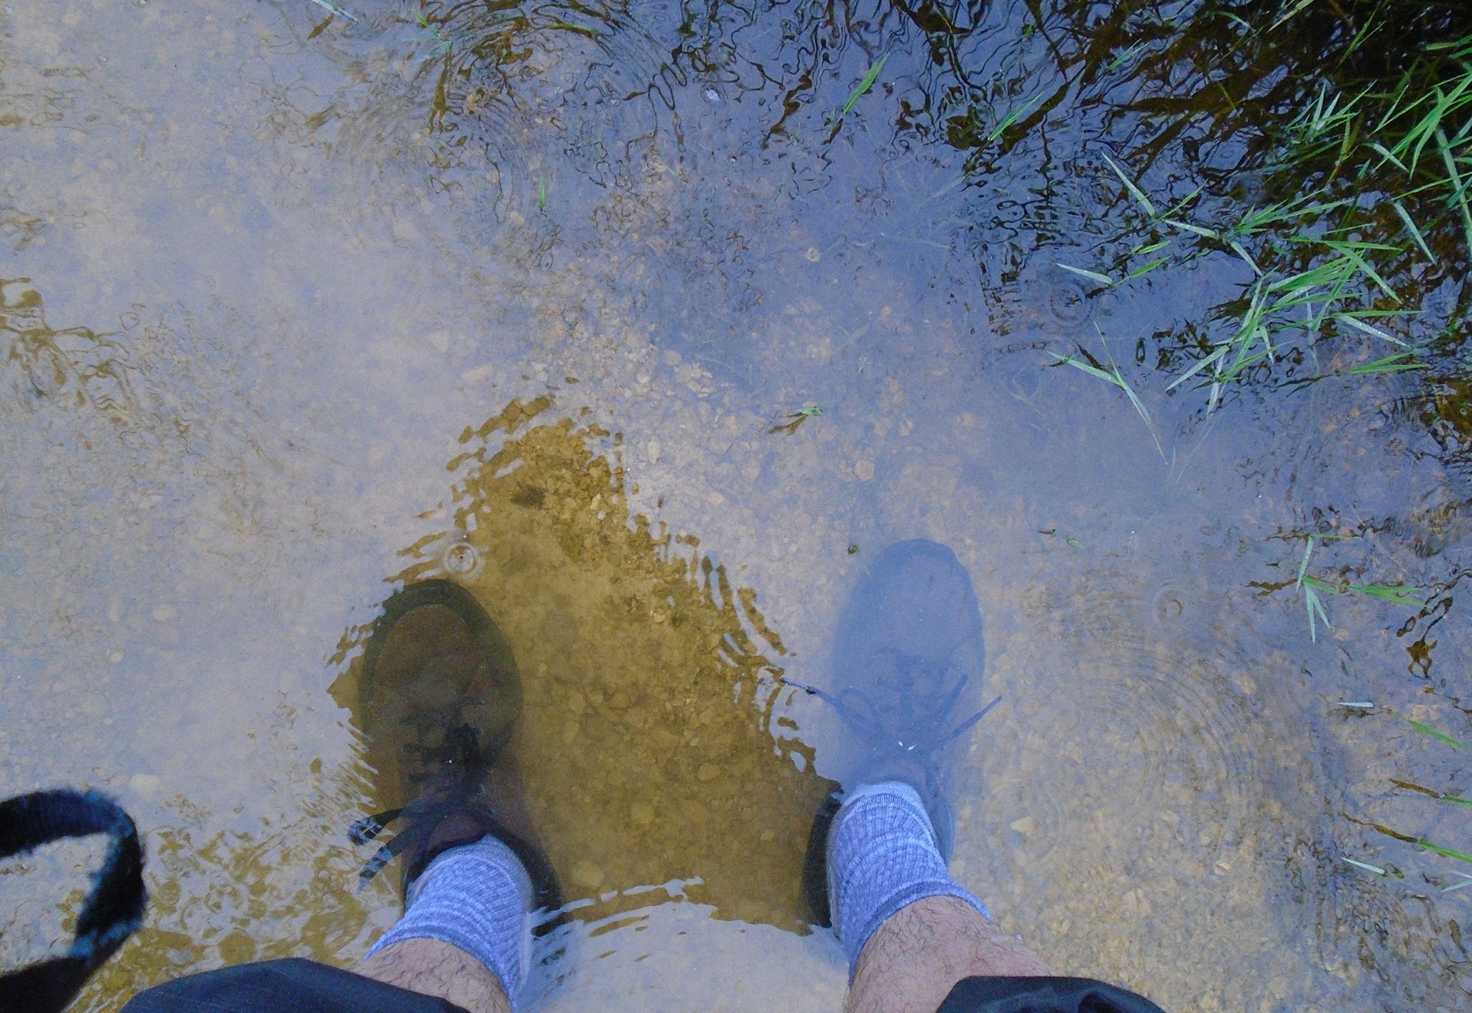
Wild Card # 3 – Framing
Yes we have no bananas
Feel, felt found formula
I was thinking about what you said …
… and you were right
Ignore, avoid, bypass
Plan to be spontaneous
Know when you lost and won
You can only get so wet.

Slide 17
Respect your “opponents”, who may be a once and future allies. Why do they disagree?

Slide 18
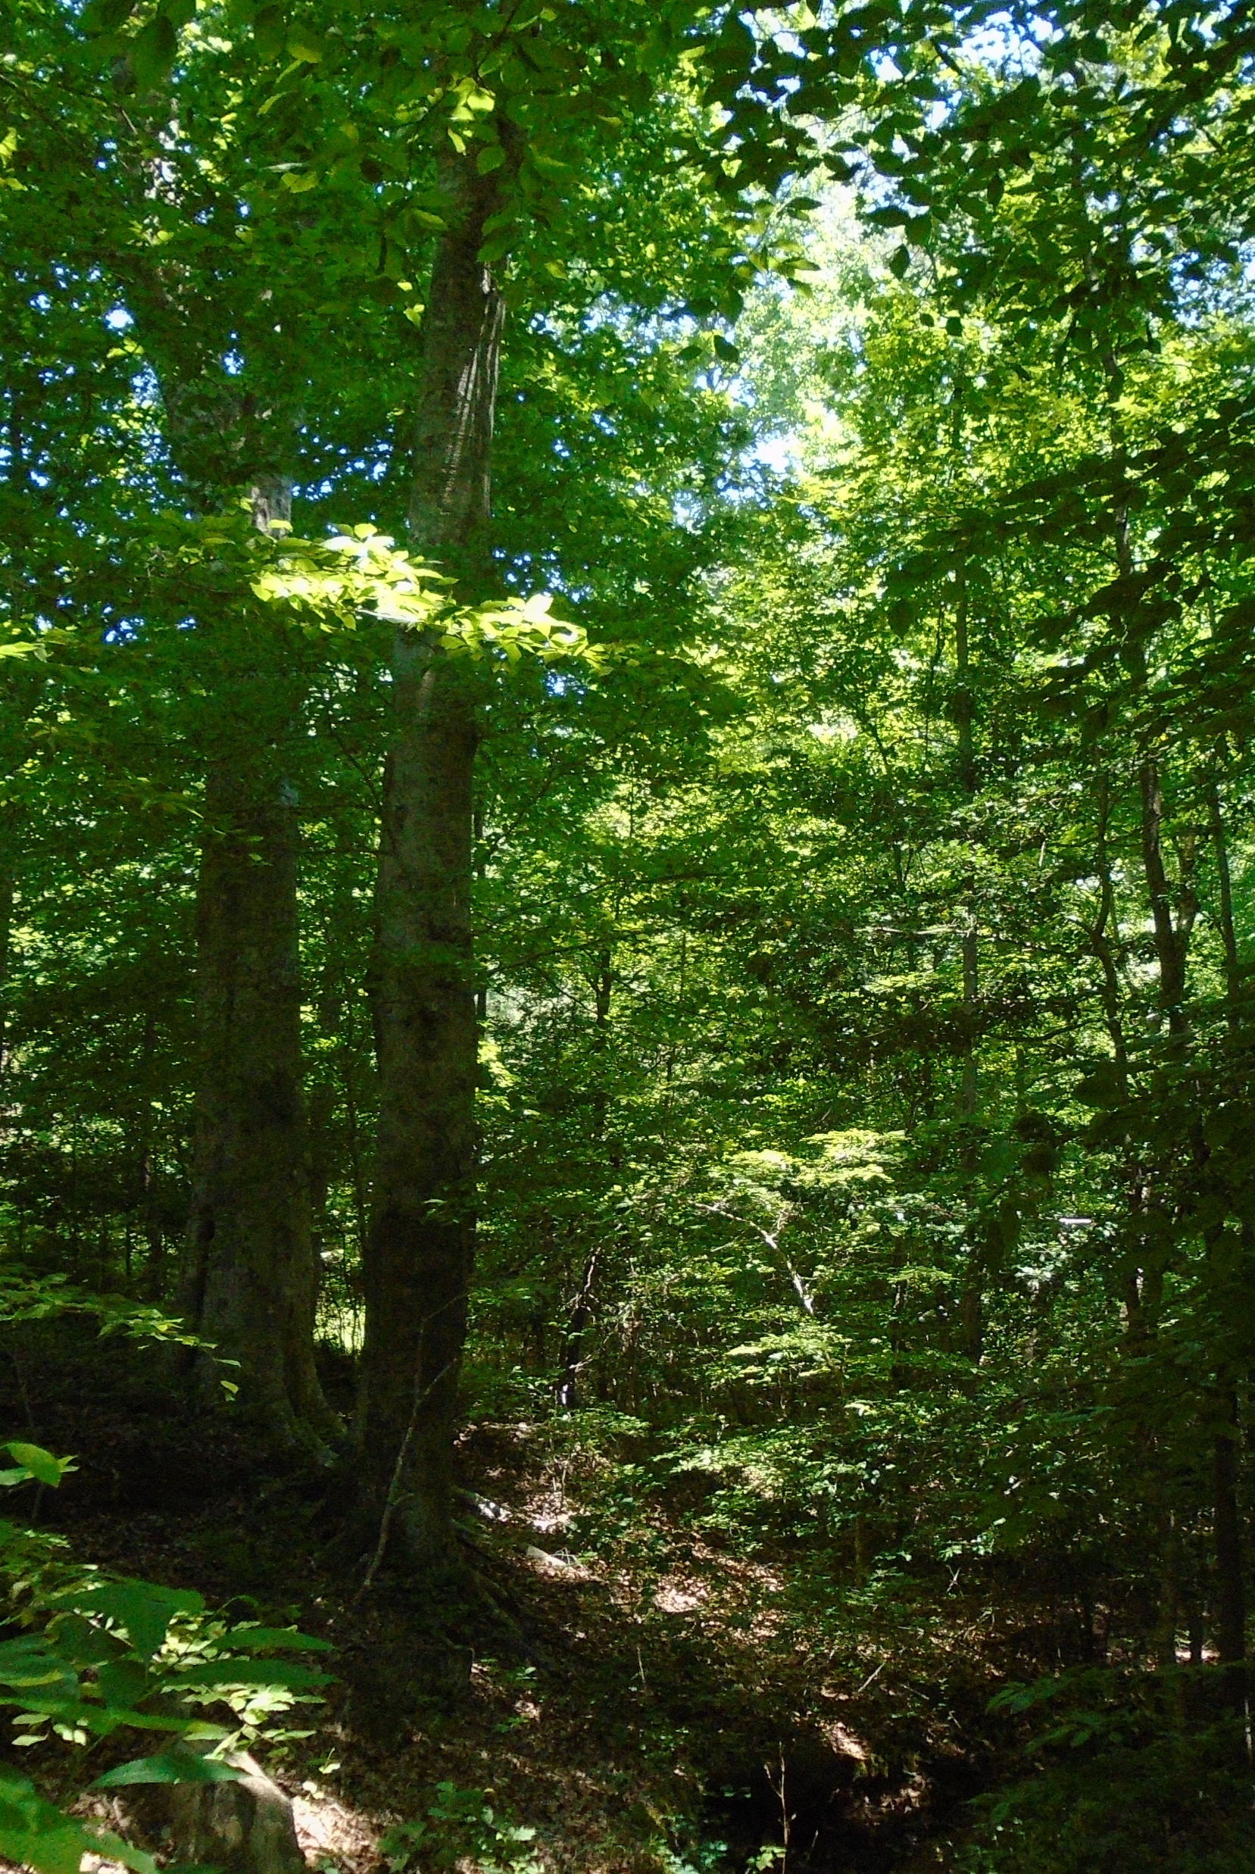
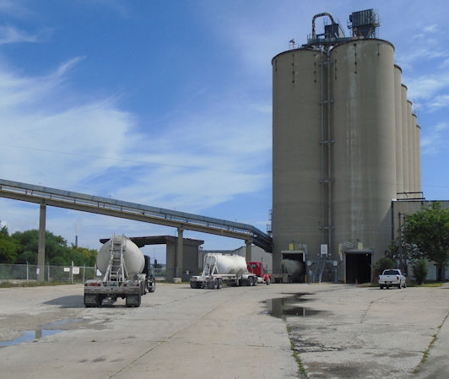
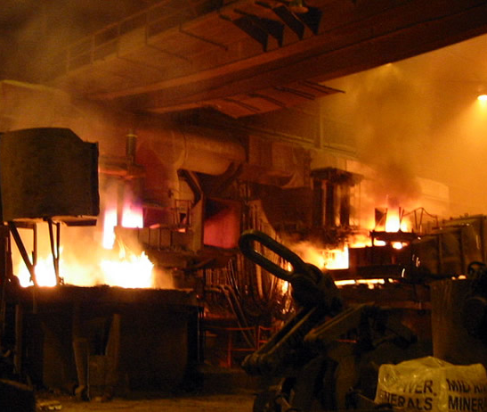
Concrete, Steel & Wood
A picture is worth 1000 woods, just show the comparison
Notes:
https://www.linkedin.com/pulse/concrete-steel-wood-john-matel/

Slide 19
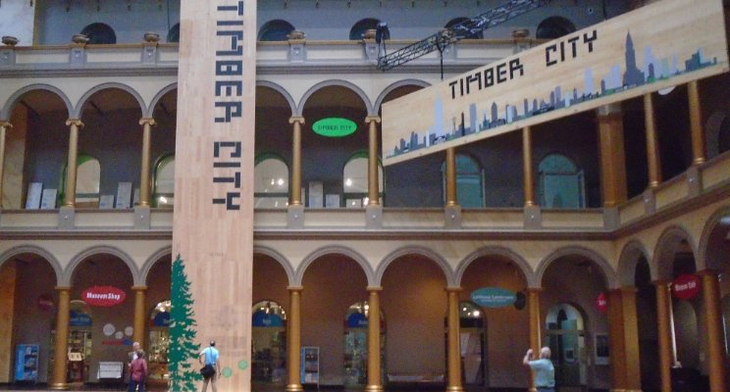
Timber Technologies
If scientists invented wood today, they would call it an advanced composite biomaterial
Notes:
https://www.linkedin.com/pulse/preservation-conservation-john-matel/

Slide 20
Reiterate – Success is continuous learning - an iterative process- not a plan – a journey not a destination - a never ending journey

Slide 21
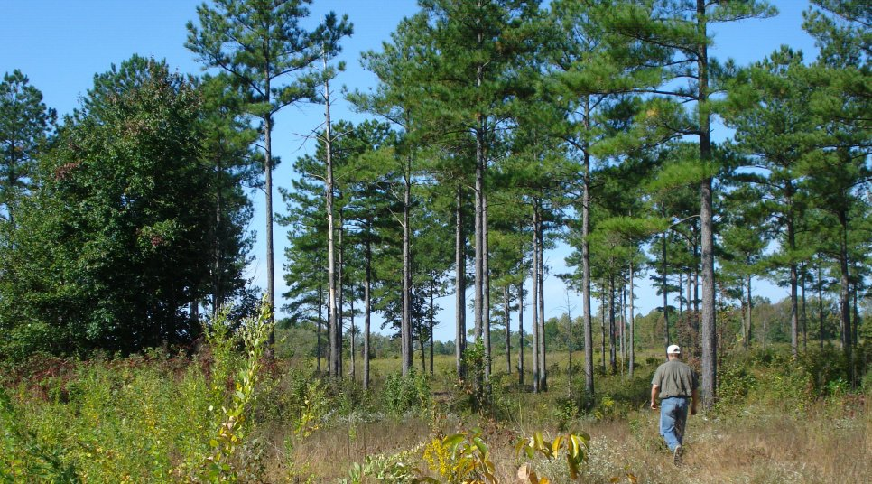
“There are two things that interest me: the relation of people to each other, and the relation of people to land.” – Aldo Leopold
I love to tell our story, to share the joy. I am morally certain that world is better for what we do, as we do forestry that not only sustains but regenerates the ecosystems of the earth. We have a great & a big story - An important story. Find your part and place to tell it. Let’s do this together.

Slide 22
John Matel – Virginia Tree Farm Foundation www.jmafe.com www.VirginiaTFF.org

