Slide 1
Social Media

Slide 2
Not a “how-to” course: the way ahead may be twisted, rough and steep

Slide 3
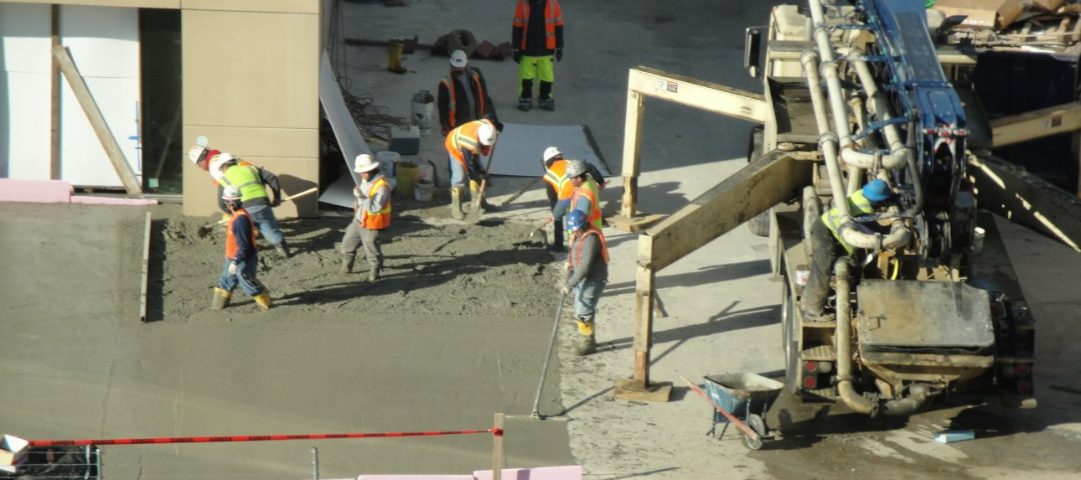
For our next trick

Slide 4
The human equation: bridging the last three feet

Slide 5
There is no garden w/o a gardener. You cannot outsource or compartmentalize your brains or your engagement

Slide 6
A learning organization: the organization as a whole needs to learn and hang onto what individuals know.

Slide 7
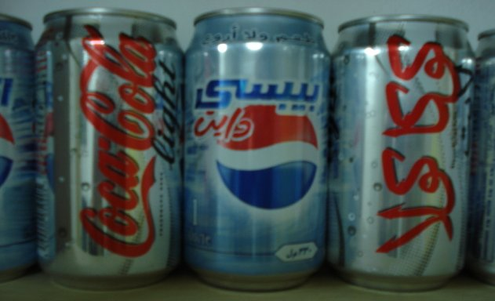
There is no such thing as a global brand or a one-size fits all. Even a ubiquitous & simple product like Coca-Cola tastes different and is marketed differently around the world.

Slide 8
Once you put something out there, it may stay for a long time and be interpreted in ways you had not imagined.

Slide 9
The mass media of the 20th Century was the anomaly. It mashed individuals into “masses”.

Slide 10
Technologies are new; human relations is old. Our “new” methods return to an earlier age when communication was engaged, individualized, personal, two-way and interactive.

Slide 11
Our new media is a restoration - a restoration on steroids that travels literally at the speed of light, but the lessons of anthropology (people) trump technology (machines.)

Slide 12
Harder to know your audience
It used to be easy to find people who connect and influence others. We looked for editors, teachers, celebrities and we tried to get them while they were young.
Now we often cannot know who is influential until AFTER they have shown influence.
We don’t know if their influence is just a one-time deal or persistent. A dynamic analysis of your audience is more crucial than ever.

Slide 13
What’s a PAO to do with the New Media?

Slide 14
Nobody can ever keep up with all technology. You don’t have to. It is getting easier to use.

Slide 15
So Let’s talk a little about the social – human aspects of the new media.

Slide 16
Humans are social creatures who make decisions in contexts of culture & relationships. The new media has made this faster and broken down the barriers of distance.

Slide 17
Information is almost free. We now must find or create communities and social context for our message root & be understood and information changed into knowledge.

Slide 18
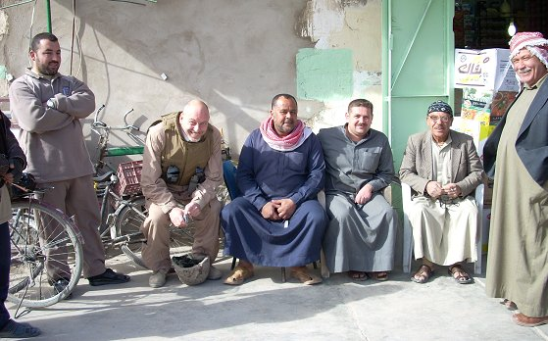
This means ENGAGE - you participate and listen to your audience, now better called your community. Engagement means influencing your community but also being part of it and willing to be influenced by others.

Slide 19
Iterative - Success in new media means is continuous learning - an iterative process- not a plan - and a never ending journey

Slide 20
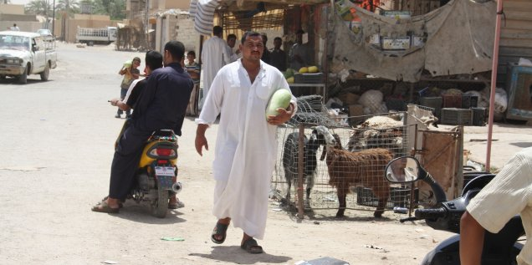
Community - Build a community & be part of a community. Figure out what you can contribute and do it. Remember people make decisions in the contexts of their relationships.

Slide 21
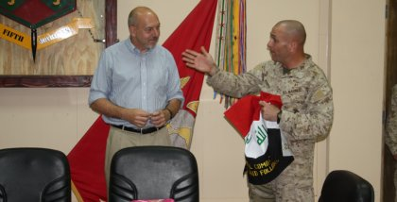
Inclusive & Exclusive - Communities are inclusive for members and exclusive for others. You attract nobody if you appeal to everybody. You have to earn membership in any community worth joining.

Slide 22
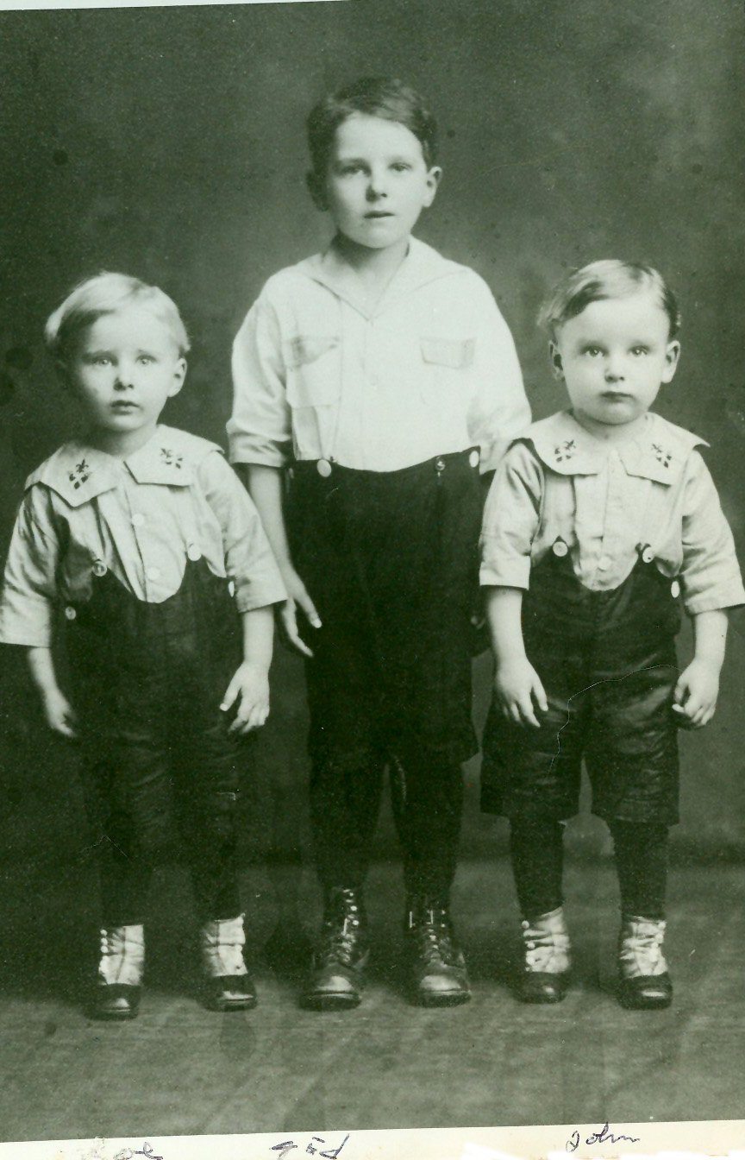
Personal – or at least personalized. Editors and marketers have tried for years to homogenize for the mass market. Niche markets – and social media is a series of niche markets – requires personality.

Slide 23
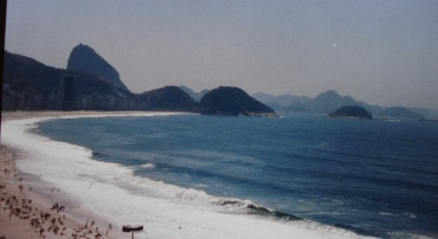
Case Study: How will the new PAO in Brazil use new media in public affairs?

Slide 24
The seven things I will do:
engage before I explain
integrate new media into everything AND integrate everything into new media
favor sustainable effects over ephemeral crowds
be willing to give up some control
know that content & human relationships trump technology
be platform flexible
try lots of things and know that some (most) will fail

Slide 25
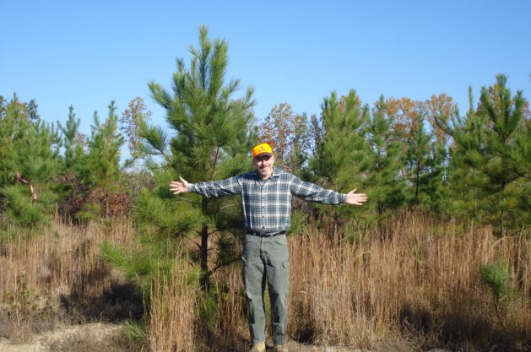
Questions? www.johnsonmatel.com/blog1

