Slide 1
The Changing Media Landscape

Slide 2
Everything is always becoming something else

Slide 3
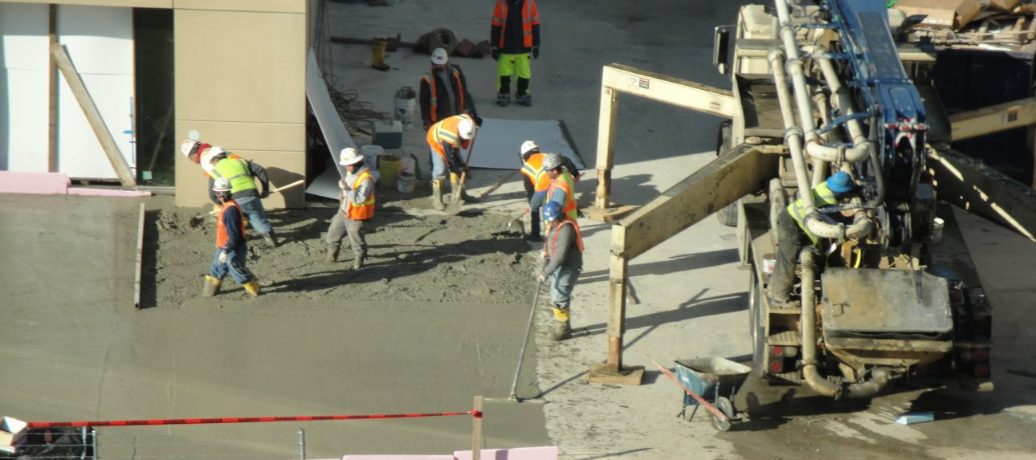
Portfolio or Toolbox Strategy (for an uncertain world)

Slide 4
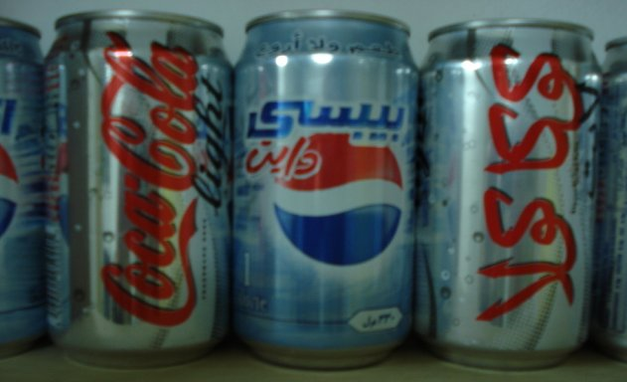
There is no such thing as a global brand or a one-size fits all. Even a ubiquitous & simple product like Coca-Cola tastes different and is marketed differently around the world.

Slide 5
The human equation: bridging the last three feet

Slide 6
There is no garden w/o a gardener. You cannot outsource or compartmentalize your brains or your engagement

Slide 7
Technologies are new; human relations is old. Our “new” methods return to an earlier age when communication was engaged, individualized, personal, two-way and interactive.

Slide 8
The lessons of anthropology (people) trump technology (machines.)

Slide 9
How does public diplomacy really work?
Forget about mass marketing & advertising analogies. We are not selling something as simple as a can of soda and we do not have the resources to engage mass markets. We are not trying to build awareness (who is not aware of the U.S.?) and content DOES matter.
Public diplomacy is a mass networking proposition, where we build key relationships and use leverage to allow/encourage others to reach out, who in turn reach out …

Slide 10
Humans are social creatures who make decisions in contexts of their culture & relationships

Slide 11
Information is almost free and a wealth of information creates a poverty of attention. We now must find or create social context for our message to get attention.

Slide 12
Understand - Everything has rules and patterns

Slide 13
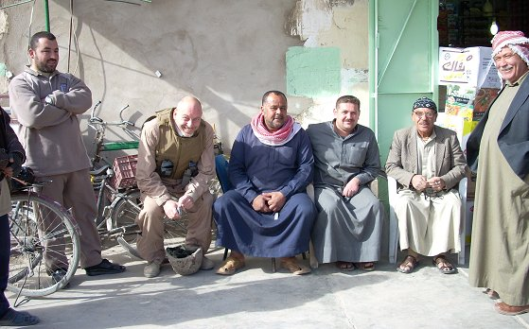
ENGAGE - influencing your community but also being part of it and willing to be influenced. You also have to get out – physically – and meet people where they are.

Slide 14
Inform – turn information into useful knowledge

Slide 15
Interpret

Slide 17
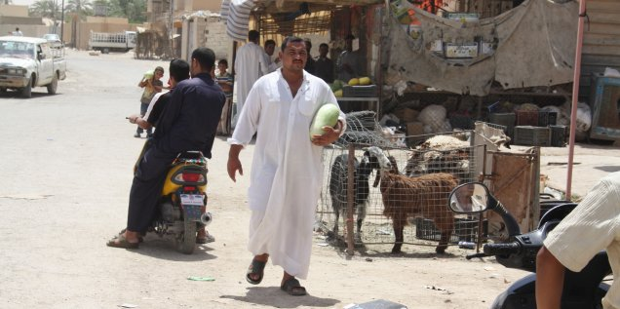
Build a community & be part of a community. Figure out what you can contribute and do it. Remember people make decisions in the contexts of their relationships.

Slide 18
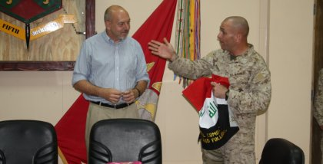
Inclusive & Exclusive - Communities are inclusive for members and exclusive for others. You attract nobody if you appeal to everybody. You have to earn membership in any community worth joining.

Slide 19
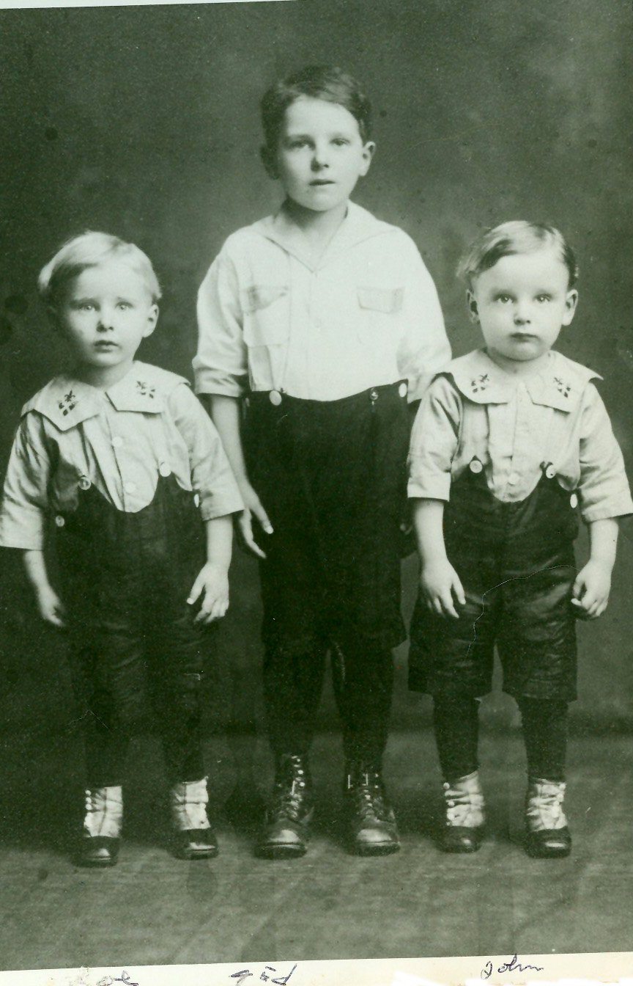
Personal – or at least personalized. Editors and marketers have tried for years to homogenize for the mass market. Niche markets – and social media is a series of niche markets – requires personality.

Slide 20
Reiterate – Success is continuous learning - an iterative process- not a plan - and a never ending journey

Slide 21
Case Study: How will the new PAO in Brazil use new media in public affairs?

Slide 22
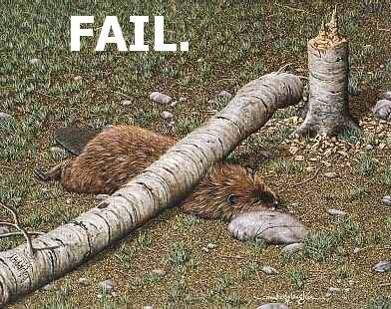
First let me go through the PAO fail list from a friend and mentor, Brian Carlson. He wrote it a while back, but it still makes sense.

Slide 23
You fail as a PAO if…
You spend more time each day in front of a computer than in front of people;
You are produce a translation summary of the news media each morning - instead of briefing the Ambassador in person;
You can’t name the fiction writer the host nation is most proud of;
Your post’s daily media summary covers the newspapers, but not radio or television;
You don’t run any analytics on the embassy website
You think receptions are useless because can’t think of something to ask the host nation guests about;
You use terms like ‘positive’ and ‘negative’ news coverage instead of ‘accurate’ and ‘inaccurate’ news coverage (we’re not marketing a toaster)
You keep your office TV tuned on one news channel;
You’ve never attended a play or live theater performed in the host nation language;
You are only asked to contribute to the Ambassador’s guest lists, not to attend;
You don’t have any Google alerts set up;
You don’t have at least one substantive conversation a day with someone who is not an American, not a USG employee, and not a third country diplomat.

Slide 24
The seven things I will do:
engage before I explain
integrate new media into everything AND integrate everything into new media
favor sustainable effects over ephemeral crowds
be willing to give up some control
know that content & human relationships trump technology
be platform flexible
try lots of things and know that some (most) will fail

Slide 25
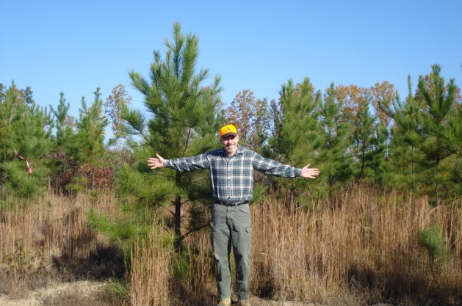
Questions? www.johnsonmatel.com/blog1

